Slide 1
Current State: FINAL
This deck is complete and has been reviewed. Note that sessions do sometimes get minor updates after the first event they are presented in.
Role | Name | Reviewed / Approved
Deck Owner | Pete Brown
Tech/Msg Review/Contrib | Rich Turner | Done
Tech/Msg Review/Contrib | Dustin Howett
Tech/Msg Review/Contrib | Yosef Durr | Done
Tech/Msg Review/Contrib | Kayla Cinnamon | Done
Tech/Msg Review/Contrib | Craig Loewen | Done

Slide 2
Key messages / take-aways for this deck
Windows Terminal
Need to move forward with your requests while maintaining compatibility
Open source is the way to go. Terminal is the new command-line for developers and users.
Learn from the source. Use it! Contribute.
Windows Subsystem for Linux
A powerful way to use your Linux developer tools and workflows on Windows
Not just for web developers: cross-platform C++ developers, etc. use this
(important for macOS compete)
Fundamentally changing to have higher performance. We’re shipping Linux with Windows!

Slide 3
Helpful speaker prep content
Windows Terminal: Building a better command line experience for developers (this is a more detailed version of what we cover in the first half of this presentation. A must-see for context and background.)
https://mybuild.techcommunity.microsoft.com/sessions/77004
The new Windows Subsystem for Linux Architecture: a deep dive (this session gets a lot from this)
https://mybuild.techcommunity.microsoft.com/sessions/77003
What’s new with WSL (quick chat. Good for high-level pointers)
https://mybuild.techcommunity.microsoft.com/sessions/77292?source=sessions
Leveraging WSL for DevOps and Cross-Platform Development (third-party session by the Penguin folks)
https://mybuild.techcommunity.microsoft.com/sessions/77165?source=sessions

Slide 4
WSL Questions to expect
SEE FAQ HERE
https://devblogs.microsoft.com/commandline/wsl-2-post-build-faq/

Slide 5
System Requirements: Terminal
Mouse with a scroll wheel
Latest May 2019 update version of Windows 10 (18362 or higher)
Developer mode enabled
1902 / 10.0.18362 or higher Windows SDK installed (see github link below for links)
Only for building, not the demo: VS 2019 with
Desktop development with C++
Universal Windows Platform Development
If VS 2019, v141 toolset and Visual C++ ATL for x86 and x64
OR Downloaded and built Windows Terminal from here: https://github.com/Microsoft/Terminal
The build must match your system architecture. Due to the driver interface, x86 will not run on x64 and vice versa.
If you don’t want to build it, Oren (RD) has put together an unofficial automated build version (don’t share this link with attendees – the previews will be in the store)
https://terminalunofficial.z13.web.core.windows.net/nightly
Latest Visual Studio Code
Also make sure Visual Studio Code is set up as default file handler for json files (required for terminal settings to work)

Slide 6
System Requirements: WSL 1
Developer mode enabled on Windows.
WSL installed on Windows (see demo steps for explanation as to how to do this)
Don’t forget your normal and admin credentials
Latest ubuntu freshly installed into WSL (you get this from the Microsoft Store).
Will likely work with other distros, but haven’t tested. Pengwin can be a fun one to use because it’s build for WSL.
Make sure you have the latest bits in Linux.
$ sudo apt update
$ sudo apt upgrade

Slide 7
System Requirements: WSL 1 - X
VcxSrv installed and configured on Windows (yeah, I know. We all hate going to sourceforge, but that’s where it is. Just run some solid ad-blocking). Be sure to install the fonts as well.
https://sourceforge.net/projects/vcxsrv/ (NOTE: Also put a version in Teams files area)
Configure to have multiple windows, because showing X windows and Windows windows on the screen at the same time tends to be the most impressive
When running, choose “start no client”
Default settings are fine. (Clipboard on, Native opengl on)
Save the config
Allow it through the firewall on public & private networks
Some other x servers work as well, like MobaXTerm. Only pick something else if you already know how to make it work.
WSL configured for X
Update your .bashrc to export the display
Export DISPLAY=:0
ssh server should be running. If for some reason, it is not installed or working:
$ sudo apt remove openssh-server
$ sudo apt install openssh-server
A few X apps installed in WSL
$ sudo apt update
$ sudo apt install x11-apps
$ sudo apt install firefox
To test
$ xeyes
It should follow your mouse cursor, and you can also resize it, etc.
$ firefox
Should work. Browse to insiderdevtour.com

Slide 8
System Requirements: WSL 2
Because this requires a build of Windows that won’t be available in the Insider Program until late June or July, we’re not going to do any special setup for WSL2
We’re going to provide a demo video that you can talk to.

Slide 9
Speaker Technical Skills
Demos are all scripted, but the set of required skills includes
Command-line in Windows
Linux / Windows Subsystem for Linux
Including how to install software, download, navigate the file system. Nothing super advanced
Ability to talk credibly about developing with / using the command-line

Slide 10
General presentation notes
Spend the time in the demos, not the slides. Slides are there for context and basic info.
No need to go deep in the architecture diagrams. Use the talking points/scripts in the speaker notes

Slide 11
What’s New for the Command line and Windows Subsystem for Linux
<Speaker Name>
<Title>
Notes:
Hi, I’m <name> from <company>
I’m <an MVP | RD | whatever | a dev/pm/whatever on XYZ team at Microsoft>
I’m excited to be here today to talk with you about one of my favorite topics: what’s new for the command line in Windows.

Slide 12
What we’ll cover today
The new Windows Terminal
The Windows Subsystem for Linux Today (WSL 1)
The Windows Subsystem for Linux 2 (WSL 2)
Notes:
We have three main topics for today:
The new Windows Terminal
Where we are with WSL today
And where we are going with WSL in the future.

Slide 13
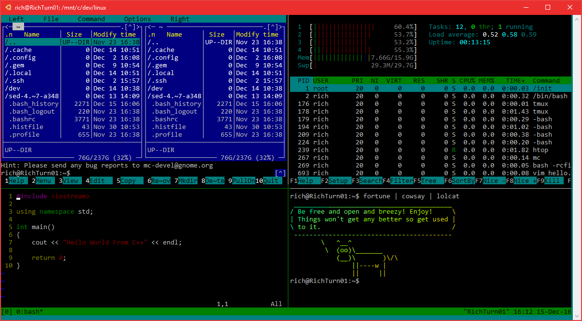
Windows Console
It’s come a looooong way!
Now ~30 years old!
Battle-tested
Fast, small, efficient
We’ve added many features
Transparency, VT, 24-bit color, ConPty
Overhauled innards
Refactored & Modularized
THOUSANDS of LoC replaced with modern C++ & safe, efficient, STL + WIL
Notes:
Click
Console has been around longer than many of the developers ☺
Used by cmd.exe, PowerShell, WSL, etc.
Click
Although the changes aren’t always obvious, we’ve done a lot of work on the console over the years.
For example, supporting 24 bit color, and VT escape sequences, line-selection copy/paste. Of course, we also added transparency as well.
Click
Internally, we’ve done a lot of refactoring. You can imagine that’s pretty necessary with a 30 year old code-base. We’ve upgraded thousands of lines of code with modern C++, and safe, efficient patterns and libraries.

Slide 14
But …
You all want more
You want tabs, emoji, Unicode / UTF-8, transparency, configurability, themes/styling
SO DO WE!
Console’s primary concern is backward-compatibility
Even small UX changes can “break the world”
Backwards compatible with MS-DOS
At some point, we need to start fresh
That time is now!
Notes:
But …
<click>
we know it was time for some big updates. You all wanted more!
You want tabs, emojis, transparency, better encoding support, configurability, themes/styling and more
<click>
So do we!
<click>
We can’t do that with the existing console app ,though, as even tiny changes can break real-world apps, including entire production lines where automated testing systems are screen-scraping console screens and a small change can bring production to a halt.
<click>
So it’s time to start fresh.

Slide 15
Introducing: Windows Terminal
Notes:
Introducing Windows Terminal!
Windows Terminal is a new, modern, feature-rich, productive terminal application for command-line users. It includes many of the features most frequently requested by the Windows command-line community including support for tabs, rich text, globalization, configurability, theming & styling, and more.
The Terminal will also need to meet our goals and measures to ensure it remains fast, and efficient, and doesn't consume vast amounts of memory or power.

Slide 16
Demo
Windows Terminal
Notes:
We’re still actively developing this, but let’s show our progress to date.

Slide 17
Terminal Demo Script: Part 1
5 minutes for all parts total
Run the new Terminal app (it will likely show PowerShell on your system) (tabs should be hidden. If they’re not in the build you’re using, it’s fine)
Mention this is VERY early alpha stuff
“Terminal is a C++ application that uses DirectWrite for high-performance text layout and rendering”
“Looks very much like the old console. But here’s a feature many have been requesting”
Hit Control-T to show tabs.
You can have multiple tabs open, each with different consoles
If you opened in PowerShell by default, click the arrow in the tabs and pick “cmd” for a new tab.
Show that normal commands like “dir” work fine. If cmd opened when launched, open a new PowerShell tab and show that. Nav back to cmd tab
“Oh. I bet folks in the back probably can’t see this text very well. Let me fix that”
Show zooming in to the text: Control and scroll wheel on the mouse
Great for presenting when you have to make text larger on the fly. Also great for accessibility
“Really cool, right?” <applause>
Notes:
Point of this demo is to introduce Terminal

Slide 18
Terminal Demo Script: Part 2
(At the cmd prompt)
“We’re going to talk about WSL a bit later, but thought I’d show this while we’re here”
“To get a list of all the distros installed in WSL, type WSL-L”
> wsl -l
“You’ll use that list of names when opening a specific distro, or when working with the shares at the command line. More on that later”
> wsl -d ubuntu
(that assumes ubuntu is the distro you are using.)
“For grins, I’m going to run the Windows cmd from within ubuntu. Check it out. I have cmd, running wsl, running cmd. Yo dawg.”
$ cmd.exe
“To get back to wsl, just exit”
> exit
“To get back to cmd, just exit again”
$ exit
“That was fun. We’ll do a lot more with WSL here in a bit. Let’s look at some more Terminal features”
Notes:
Point of this demo is to show it all works

Slide 19
Terminal Demo Script: Part 3
“You can also change things like contrast.”
Control-Shift-Scroll to change transparency (only in cmd, not PowerShell) “Dig that fluent Acrylic blur in the background, too”
You have WSL installed, so in one of the CMD tabs, navigate to type “wsl” at the prompt to get into linux.
Type cd ~ to get to your home folder
ls -al to show it working. Mention you’ll cover more WSL in a bit
“Profiles are stored in an easy-to-edit json file.”
Click the settings icon from the drop-down (you must have VS code or something as the default .json handler)
Scroll through and mention that you can change colors, starting directory, size of history, the exe to run for that command line, etc.
Scroll to the profile you’re in (It’s likely the “cmd” one)
Show both the terminal window and the json editor at the same time
Change the font size, save, and show that it is automatically reflected in the terminal app without you having to refresh it.
You can easily take this json file to other PCs, so it’s easy to move your settings from PC to PC
Close the console
Open the repo main page (see next slide)

Slide 20
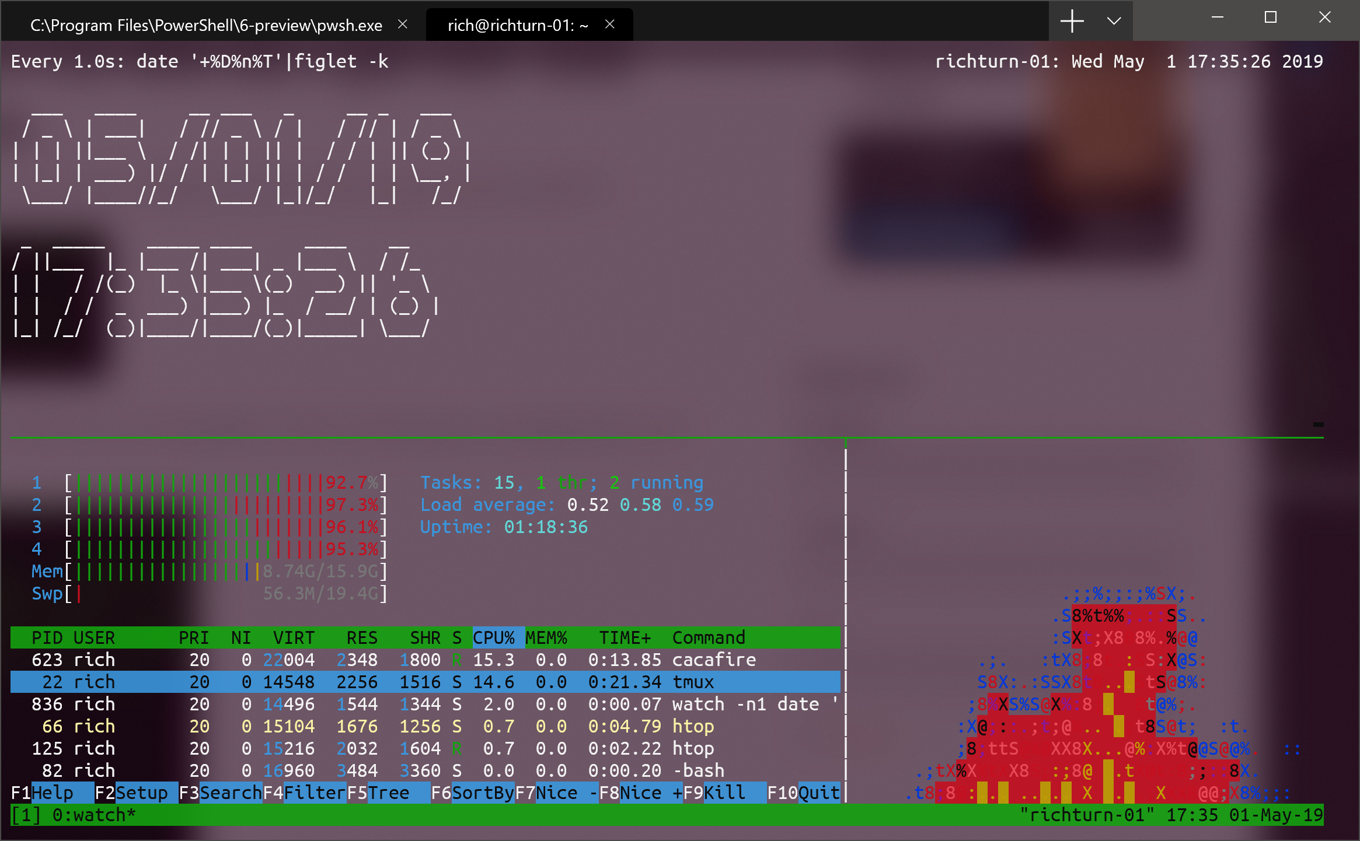
Windows Terminal v1.0 Goals
Many Planned Features
Multiple Tabs
Background transparency & blur
Customization – color themes & styles
Connectivity to local & remote shells
Beautiful Text
GPU-accelerated DirectWrite/DirectX text rendering
Unicode & UTF-8 text - CJK, Emoji, Programming Ligatures
Delivered regularly via Microsoft Store
Summer 2019: First prototype
Winter 2019: Windows Terminal v1.0
Notes:
What are our goals for 1.0?
<click>
We have many planned features, including tabs, customizationa, dn more
<click>
We want beautiful GPU-accelerated text
<click>
And we want to deliver regularly from the Microsoft Store
Windows 10 May 2019 Update is the baseline version for support of the new Terminal. From then on, you’ll be able to get new versions via the Store, or of course, build it yourself from our Github Repo.
(Screen shot is WSL/Linux instance running in this tab using tmux to split the console into different windows.

Slide 21
Demo
Windows Terminal OSS

Slide 22
Demo Script: Windows Terminal OSS
2 minutes
Open the Github repo page (link in setup slides)
“We’re developing Terminal completely in the open, on GitHub”
“You can download and build the source yourself. It includes the ColorTool for setting the color scheme for the terminal, as well as sample projects and documentation for consuming the console APIs from your own applications. Not only that, but we’ve also open sourced the command-line infrastructure of Windows itself and are taking pull requests.”
“Terminal will be in the Store soon, and can be downloaded by anyone.”
Navigate to /master/src/Cascadia/TerminalApp. Click on Tab.cpp
“Terminal uses Win32 and UWP code in the same application. The shell of the Terminal, including tabs, is all implemented as UWP controls leveraging Windows.UI.Xaml”
Navigate to /master/src/Cascadia/TerminalControl . Click on TermControl.cpp
The console control itself, what renders the text on the screen and handles the interaction, is a control we’re making available to you to be able to incorporate into your own applications. For example, we’re working with Visual Studio to integrate this control so they have a more robust console experience. When you live in a console experience, you realize none of the existing controls support the exact grid spacing experience, not Rich Text Box, text box, etc. So we’re making this available to you. What do you think?” <applause>
Notes:
Cascadia was the code name for Terminal

Slide 23


WSL 1
♥
Notes:
One of the use-cases for the new Terminal is the Windows subsystem for Linux.
Who here has used WSL?
(depending on audience, likely to get around ¼ to ½ the room)
(if you have experience talking about WSL with different communities, adapt this for your story)
WSL is one of the topics I speak about at events all around the world. I’ve had the opportunity talk with developers who mostly work on other operating systems. In one case, almost no one in the room realized that you could run Linux on Windows! They were thrilled to learn that, not only is it great for web developers, but cross-platform C++ developers can often run their build processes on it as well.
Personally, I use WSL for some tools, but mostly for a replacement for most ssh clients. I run an Ubuntu Minecraft server with my son, and I do all my management of that server and its apps through ssh in WSL.
Note that we’re calling the current version “WSL 1”. We’ll talk about the upcoming “WSL 2” in a few minutes.

Slide 24





WSL 1 Architecture
Linux Distribution
WSL
Windows NT Kernel
Notes:
Here’s a little background on WSL 1
<click>
We have Linux usermode binaries. These are not shipped as part of Windows. You can get them from the store or side-load them.
<click>
The WSL translation layer is a driver that we call lxcore, or Linux core. It implements the Linux kernel ABI and translates Linux syscalls to NT equivalents.
<click>
Then, under that, we have the Windows kernel itself.

Slide 25
WSL 1 Architecture
Linux Distribution
WSL
Windows NT Kernel
Notes:
Linux is rapidly-evolving and adding new features. These need to be reimplemented in our translation layer.
This adds a delay between when the Kernel adds a feature and when it’s available to our users
We want users to have the latest and greatest functionality
Windows is a powerful and flexible platform but there are fundamental differences between Windows kernel and Linux Kernel
Filesystem
Permission model
Memory manager
Device model
These differences can cause performance or compatibility issues.
For example, Implementing filesystem semantics on top of Windows causes slowdown.
This is the primary reason why file IO is slow in WSL1

Slide 26
Demo
A lap around WSL 1
Notes:
In the keynote, you saw remote debugging with VS Code and WSL. That’s one of my favorite web features. Let’s take a step back and look more at what you can do with the WSL, as a web dev, but also as a .NET developer and more.
Let’s take a lap through WSL 1 from the basics to some really interesting tips.

Slide 27
WSL Demo Part 1: Showing setup
1:30 minutes
Open Windows Settings. Type “Developer” in search and bring up Developer Settings (or go into Update & Security and click on “For developers”
“The WSL is a developer feature, not something for the typical consumer. To use it, you need to enable Developer mode in Windows settings. As a dev, you may have this enabled already.”
“Once you have developer mode enabled, you need to turn on the feature in Windows.”
In search box, type “features” and then click on the “Turn windows features on or off” to bring up the features dialog
Scroll down to show the “Windows Subsystem for Linux” feature.
“I already have this installed. When you install it for the first time, you’ll select this feature, reboot, and then install the distro you want from the store”
Open the store, type “linux” in the search
Show the distros you can pick.
“You can use any of the distros here, and they are as simple to install as any other app in the store”
“As an aside, the Pengwin distro you see here is a version of Linux build specifically for the WSL.”

Slide 28
WSL Demo Part 2 : Shell
See recording for timing
Basics (Test this all well in advance in case your PC has permissions issues and you have to use a different folder)
Make an empty folder on your desktop, called “wsltest”
Navigate into the folder with explorer (leave this open for the demo)
Shift and right-click and choose “Open linux shell here”
Or, in that same explorer window, you can type “wsl” in the path nav at the top
This will open WSL (in the old console, but that’s ok here. If you want the new Terminal, you’ll need to run it and then nav to this folder)
Type ls –al or the alias ll to show the contents of the folder
“You can see that my Windows native folder here is available under /mnt/whatever/blah
“All the usual linux commands work”
Type “df” to see disk space and not that it shows all the Windows drives as well
Type “top” to show the processes running in linux. Control-C to exit.
Notepad
In linux, create a new text file of any name like “hello.txt” as long as it ends in “.txt” . Use your favorite editor. I use nano
Make sure to type a few lines of text in the file
Close the editor (nano is control-o to save, control-x to exit) vim is, well, if you’re using vim, you should know how to exit :D
Go back to Windows and double-click the new file
“Windows can access this file because it’s saved in the Windows file system. Hey, check out how Notepad now recognizes that it has Unix line endings, and properly handles that! Cool, right?” <applause, hopefully>
“Launching Windows exes from the Linux shell is a relatively new feature. You can also launch Notepad, or any other exe in the Windows path, directly from WSL.”
In linux, type “notepad.exe <filename>” where filename is the file you created above.

Slide 29
WSL Demo Part 3: Linux file system access
1:45 minutes
As of Windows 10 May 2019 update (19h1 / 1903) Windows can now access the WSL files through built in 9P / Plan 9 file share support.
“With the latest release of Windows, we now have a supported way to access the WSL linux file systems for both WSL 1 and WSL 2. It uses Plan 9 /9P protocol for network access, just like you might between actual physical machines.”
Show how you can access files
Open Windows explorer
Type \\wsl$ in the address box
“You can also type \\wsl$\distroname to go right to the file system for that distro”
Double-click the distro
Click into home/username to look at files
Right-click .bashrc and choose “Open with Code” to show you can open this in VS code in Windows.
“This is a big deal, because access TO the linux file system in the past was cautioned against because you could easily corrupt file properties.”
“In a future build of Windows, you’ll have a nice little Linux icon in the left pane of explorer, so you don’t need to remember the \\wsl$ path.”
Notes:
https://en.wikipedia.org/wiki/9P_(protocol)

Slide 30
WSL Demo Part 4 : .NET Core
See recording for timing
“This linux instance also has .net core 3 installed”
$ cd ~
Type “dotnet” at the wsl command prompt
(if this fails, make sure you’ve put the path and dotnet exports in your .bashrc as indicated in the system requirements/setup at the start of this doc)
“We’re going to use the dotnet console app template to create a Hello World”
$ dotnet new console -o myapp
$ ls -al or ll to show the myapp folder
Edit the program
“You’ve already seen how I can use native Linux editors, as well as invoke the Windows Notepad. I prefer VS code for this type of work”
$ cd myapp
$ code .
Change the “Hello World!” to “Hello <city name> from .net core 3 on WSL!”
Save
Make sure you are still in the ~/myapp folder.
Type $ dotnet run
It will load up .net core runtime and then run the application. You should see console output
“that was super easy. You can do a lot more with this, of course, and it’s an easy way to create linux binaries, test, and more for not just .net, but also python, node, C++, and many other languages, using the convenience of the native toolchains on linux, all without having to spin up a dedicated VM or use a separate linux box.”
“The dotnet.Microsoft.com site has a lot more information about running .net core on Windows, Linux, macOS and more.”

Slide 31
WSL Demo Part 5: X Server
See recording for timing
(This demo tends to really gets people out of their seats. Requires that you have VcxSrv installed and configured on the PC)
“Ok. That was all cool, and helped show the command-line shell capabilities of WSL. But sometimes you want to use a graphical tool on Linux, to test or for other reasons”
“I have running on my PC here, an X-server. I’ve also installed a number of X Windows apps on WSL”
“Now, we don’t officially support running an X-server with WSL, but it does happen to work quite nicely. There are a few different ones out there: x410 in the store, Xming and VcxSrv available online. Of them, devs seem to have more success with VcxSrv. You may get odd errors here and there, but basic applications tend to work.
$ xeyes
“X eyes is fun, but let’s say I want to test behavior with the Linux version of Firefox”
$ firefox
Navigate to InsiderDevTour.com (this won’t work from the command-line, so do it from the app UI)
“Yes, that’s the linux build of Firefox, running in an Xwindow, from WSL, on Windows”
“You can also run full window managers such as xfce or gnome. Again, it’s not officially supported, but there are lots of folks with tutorials online.”
Notes:
If any of this fails
First, make sure you have $ export DISPLAY=:0 either in your .bashrc or typed before you open xeyes
If it still fails, remind folks that it’s not officially supported. ☺
Always reboot after a practice session / before you do this demo live.
In the recording, I also show how I open vcxsrv and run it, and then set the display. Firefox fails because I made the mistake of installing Gnome in this instance and didn’t get to manage all the setup for it.

Slide 32




WSL Community
3940+
Issues filed
31,660+
Comments
12,907,546+
Individual Characters
OR
UserVoice
2.65x
Harry Potter Series
1.65x
Game of Thrones Series
Notes:
We announced WSL 3 years ago (2016) and have taken feedback on Github, Twitter, UserVoice and more
<click>
The community has been REALLY active with that feedback!
<click>
So much so, that we’re around 2.65 x the number of words in the entire Harry Potter series
<click>
Or roughly 1.65 x the length of the entire Game of Thrones series (and this will continue to grow, unless GRR Martin starts writing again, and soon!)
--- data ---
Average English word length is 4.5 letters
12,907,546 characters in all comments in repo
1,084,170 words in harry potter series -> 4,878,765 characters
1,736,054 words in GoT -> 7,812,243
2.65x Harry Potter
1.65x GoT
----
How many tweets about ‘Windows Subsystem’?
How many total words on GitHub? (731,360+, equivalent of first 6 Harry Potter books over 3 years)
How many comments on GitHub? 31,652
How many votes on UserVoice? (17,544+)

Slide 33

Top Customer Asks
⏱
File System Performance
Compatibility
Notes:
These were the top two customer requests that we weren’t able to reasonably address in WSL 1.
So…

Slide 34
Introducing: WSL 2
Notes:
We’ve created WSL 2!

Slide 35
What exactly is WSL 2?
Linux Distribution
WSL
Notes:
WSL 2 is a new architecture for WSL, with the primary goals of improving file system performance and compatibility.
We’ve made significant changes to the back end of WSL – the part Linux runs on.
Distro install story doesn’t change. The way you use it doesn’t change. Should be transparent to you.
We call it WSL 2 as we fundamentally changed how WSL interacts with your Linux binaries, and we will be distinguishing between the initial version of WSL, which we will now call WSL 1.
A Linux distro can either be running on top of WSL 1 in the back end or WSL 2, you can switch back and forth. We’re not getting rid of WSL 1, but we think you’ll really like WSL 2.

Slide 36
File System Performance
WSL 2 speed comparison test WSL 1 on a Surface Laptop
git clone
2.5x
faster
npm install
4.7x
faster
cmake
3.1x
faster
Test/Version | WSL 1 | WSL 2 | Linux VM | Mac
Git clone VSCode | 45.86 | 17.63 | 18.368 | 20.51
Npm install | 33.94 | 7.239 | 7.165 | 9.57
Cmake on OpenCV | 123.38 | 39.73 | 21.75 | 44.78
MYSQL Operation | 30.97 | 20.63 | 29.89 | 46.94
Notes:
The first change that you’re going to notice when you start using a distro with WSL 2 in the backend is the file system performance.
<click>
It’s faster. MUCH faster. So I ran some common commands in WSL 1, and WSL 2 to compare their speeds.
In general, you’re going to find that WSL 2 has a noticeable file speed performance increase. Let’s take a look at exactly what that’s like.

Slide 37
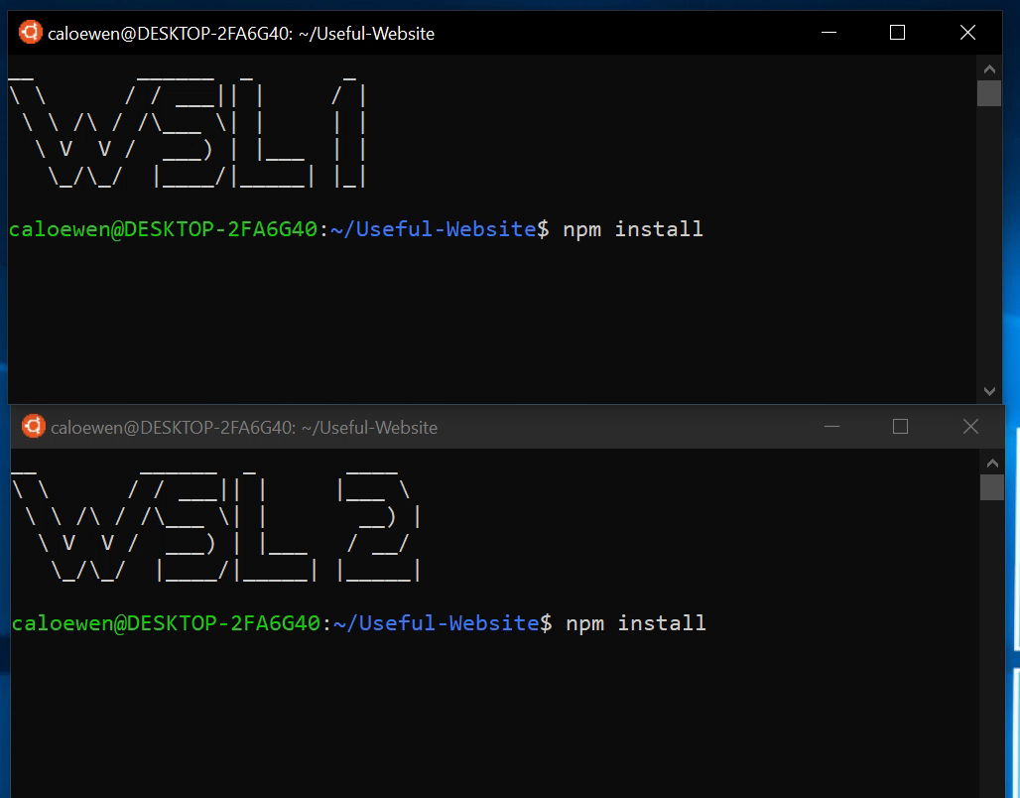
WSL 2 Outperforms WSL 1
Notes:
Check this out. The top is WSL 1, the bottom is WSL 2. Look at how much faster WSL 2 is!

Slide 38
WSL 2 Outperforms WSL 1 - again
Notes:
Let’s look at this one more time, in case you missed it.
I’m going to keep showing this until the whole room applauds!

Slide 39



Differences between Windows and Linux
folder
file.txt
Windows
OpenFile(“C:\\folder\\file.txt”, …);
RemoveDirectory(“C:\\folder”);
ERROR_SHARING_VIOLATION
Linux
open(“/folder/file.txt”, …);
unlink(“/folder”);
SUCCESS
Notes:
So why did we take the new approach?
<click>
In WSL 1, we implemented the Linux syscalls in Windows, and redirected them to the internal NT calls. That resulted in a lot of complexity because the two operating systems have fundamental differences.
<click>
On Windows, you use OpenFile to open a file in a folder
<click>
If you then attempt to remove that folder
<click>
You get a sharing violation.
<click>
On Linux
<click>
You open a file
<click>
If you then unlike (remove)t that folder
<click>
It all works just fine!
One isn’t necessarily better than the other, but different. When we translate the existing calls to NT calls, we have to also translate the behavior. Not only can that affect performance, but there are app compat considerations both for Windows and Linux.

Slide 40


So… How does it work?
Linux Kernel
Virtualization
Notes:
WSL 2 is powered by the latest and greatest virtualization technology, what better way to emulate something than to actually run it!
That’s why we are also using an actual Linux kernel inside of WSL 2. We’re no longer doing the redirection in WSL 2.
So we’re using Virtulization and the Linux kernel, where does this Linux kernel come from? Good question!

Slide 41
Shipping a Linux Kernel with Windows!
Built from Linux 4.19
Latest stable branch
Specially tuned for WSL 2
Fully managed by Microsoft
Built in-house, will be serviced via Windows Update
Open Source! Same source you see at Linux.org
Notes:
We’re starting with the 4.19 kernel. This is the same source you see at Linux.org
We don't just love and use Linux, we’re now shipping Linux!
This kernel is tuned by Microsoft to be optimized for size and performance. We’ve also removed unnecessary device support, and tuned it for WSL 2.
How fast is it? It boots in around a second.
This is fully managed by Microsoft, monitored for security issues, built in-house, and serviced via Windows Update.
By using an actual Linux kernel, we maximize compatibility for the linux applications and services you need.

Slide 42
Light-weight Utility VM
Microsoft’s Virtualization technology has improved since WSL was created.
Light-weight utility VM
Originally developed for Server scenarios
Hyper-V isolated containers
Fast boot time to spin up new containers quickly
High density (low overhead)
Can run lots of containers on a single host machine
Uses real Linux kernel for perfect compatibility and improved performance.
ext4 root filesystem
Notes:
So why did we go back to the idea of virtualization now?
The choices we made for WSL 1 were right for the time. This approach wouldn’t have been possible a few years ago when we first created WSL. One of these improvements is the Light-weight utility VM.
Virtualization stack has LOTS of great new functionality, and the lightweight utility VM, which was originally designed for real-time container spin-up on servers, is perfect for what we’re doing on Windows. It has geate isolation, super fast boot time, and very low overhead.

Slide 43
WSL 2 Architecture Overview
Lightweight Linux Utility VM
GNU/Linux Userspace Binaries
Windows Usermode
Linux Usermode
WSL Translation Layer
Windows NT Kernel
Linux Kernel
Hypervisor
Windows NT Kernel
Notes:
So now, rather than Linux Usermode talking to WSL and then to the Kernel, we manage everything in a very standard way, through the hypervisor. The end result is increased performance and compatibility with Linux on Windows
All this leads to better compatibility. That means we can now support things like running Docker containers in WSL.

Slide 44
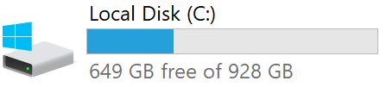
Complete WSL 2 Architecture Diagram
Interop Command
Virtual Machine
wsl.exe
Lxss Manager Service
Ubuntu
4
9P Protocol Server
1
init
2
3
bash
cmd.exe
VM Worker
Host Compute Service
Debian
9P protocol server for Windows files
9P Protocol Server
init
Linux Files
bash
Linux Kernel
Windows Files
explorer.exe

Slide 45
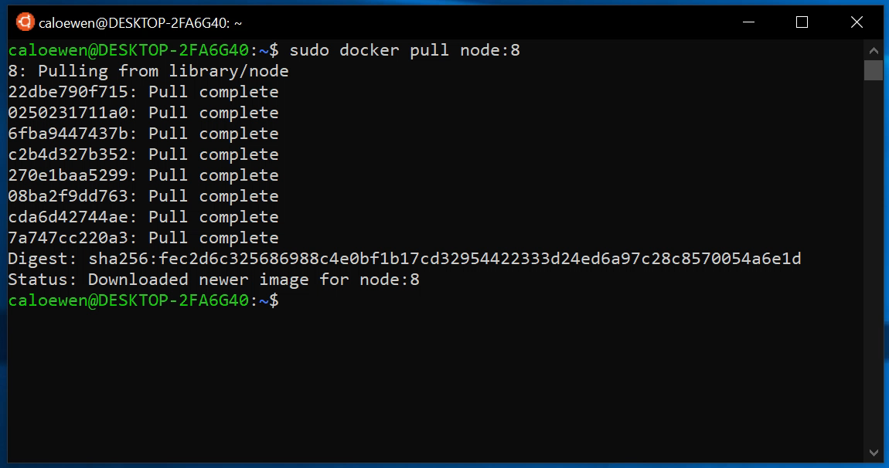
Run Docker in WSL 2!
Notes:
You saw this in the keynote. Because WSL 2 has better sys call compatibility, we can support more applications, like docker!
We've pulled down a node container, and we're just running some simple commands inside of it
This is all being supported by the Linux version of docker, and is running entirely in WSL 2.

Slide 46
WSL 2 Summarized
Greatly improved performance
Better resource usage
Better startup time
Much better native Linux file system performance
Improved compatibility
Full syscall compatibility due to shipped kernel
Did I mention we’re shipping a Linux kernel with Windows?
Standard way to access Linux files
Plan 9 / 9P – Also in WSL 1 as of Windows May 2019 update
Coming to Windows 10 Insider Builds this summer!
Notes:
WSL 1 is awesome and available today
WSL 2 has greatly improved performance.
It has improved compatibility so your Linux applications will just work.
Look for it in the Windows 10 Insider builds this summer

Slide 47
WSL Roadmap
=
🙋‍♀️
🙏
Continue to make WSL 2 feel the same as WSL 1
Improving Integration
Top Customer Asks
Notes:
Right now, we’re focused on making WSL 2 as feature rich and capable as WSL 1, while continuing to ensure performance is better, and we have everything developers on Windows need.
When you get the Insider Build (you’re all Windows Insiders, right?!) We’d love for you to try it out and send us your feedback.

Slide 48
The Command line on Windows
For Developers and IT Pros, Windows now has the best command-line experience ever!
PowerShell
cmd.exe
Windows Subsystem for Linux 1
Windows Subsystem for Linux 2
Windows Terminal
Notes:
Between WSL and the new Windows Terminal, we want to help developers and IT pros be as productive as possible, and enjoy what they do.
We hope you try out Terminal and WSL today!

Slide 49
aka.ms/insiderdevtour-labs
Notes:
“This session doesn’t have a specific lab, but we have lots of other labs that you should check out on Dev Collective, many of which include command-line and WSL components.”
Thanks!

